Slide 1
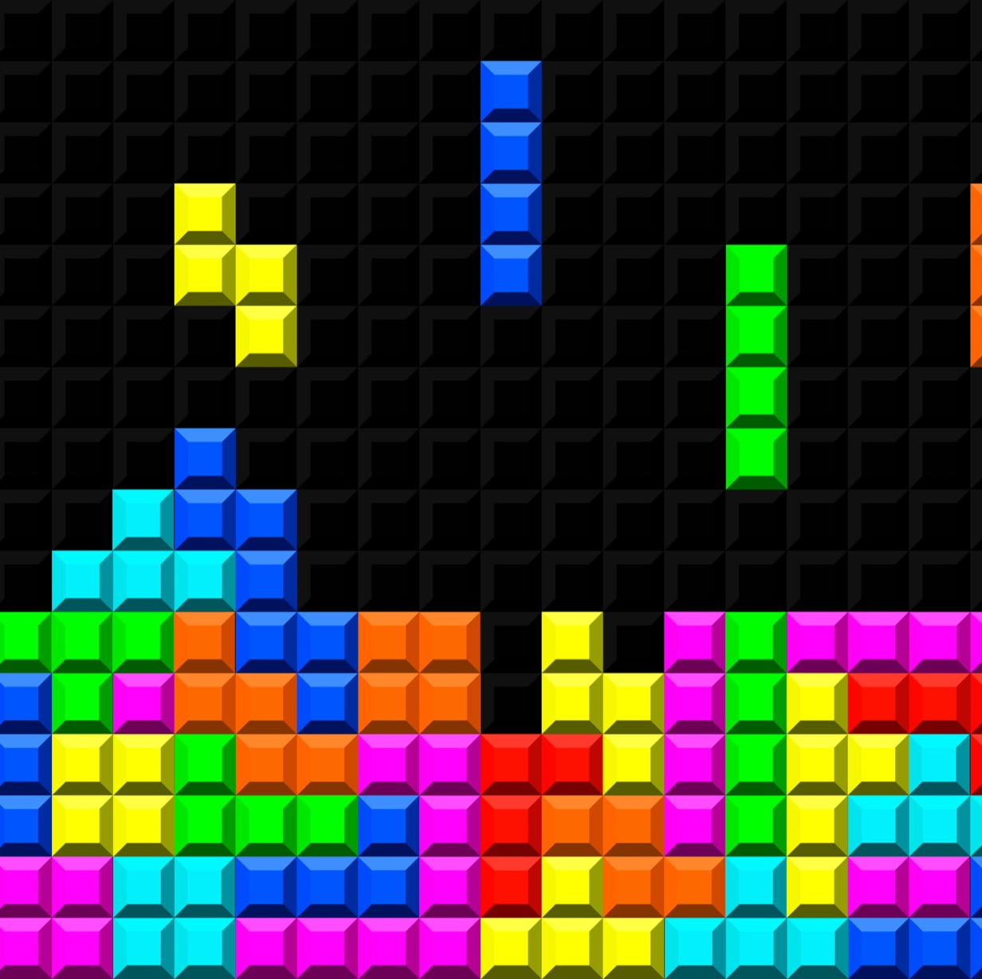
Triste
Created by :
MOLLY-MITTON Clément
BENDAVID OUYOUSSEF Sarah
HUBNER James
ARROUET LE BRIGNONEN Aubin
MOBLEY Erin

Slide 2

Introduction
the project's objectives :
- Recreation of Tetris
- Development of an AI mastering Tetris

Slide 3
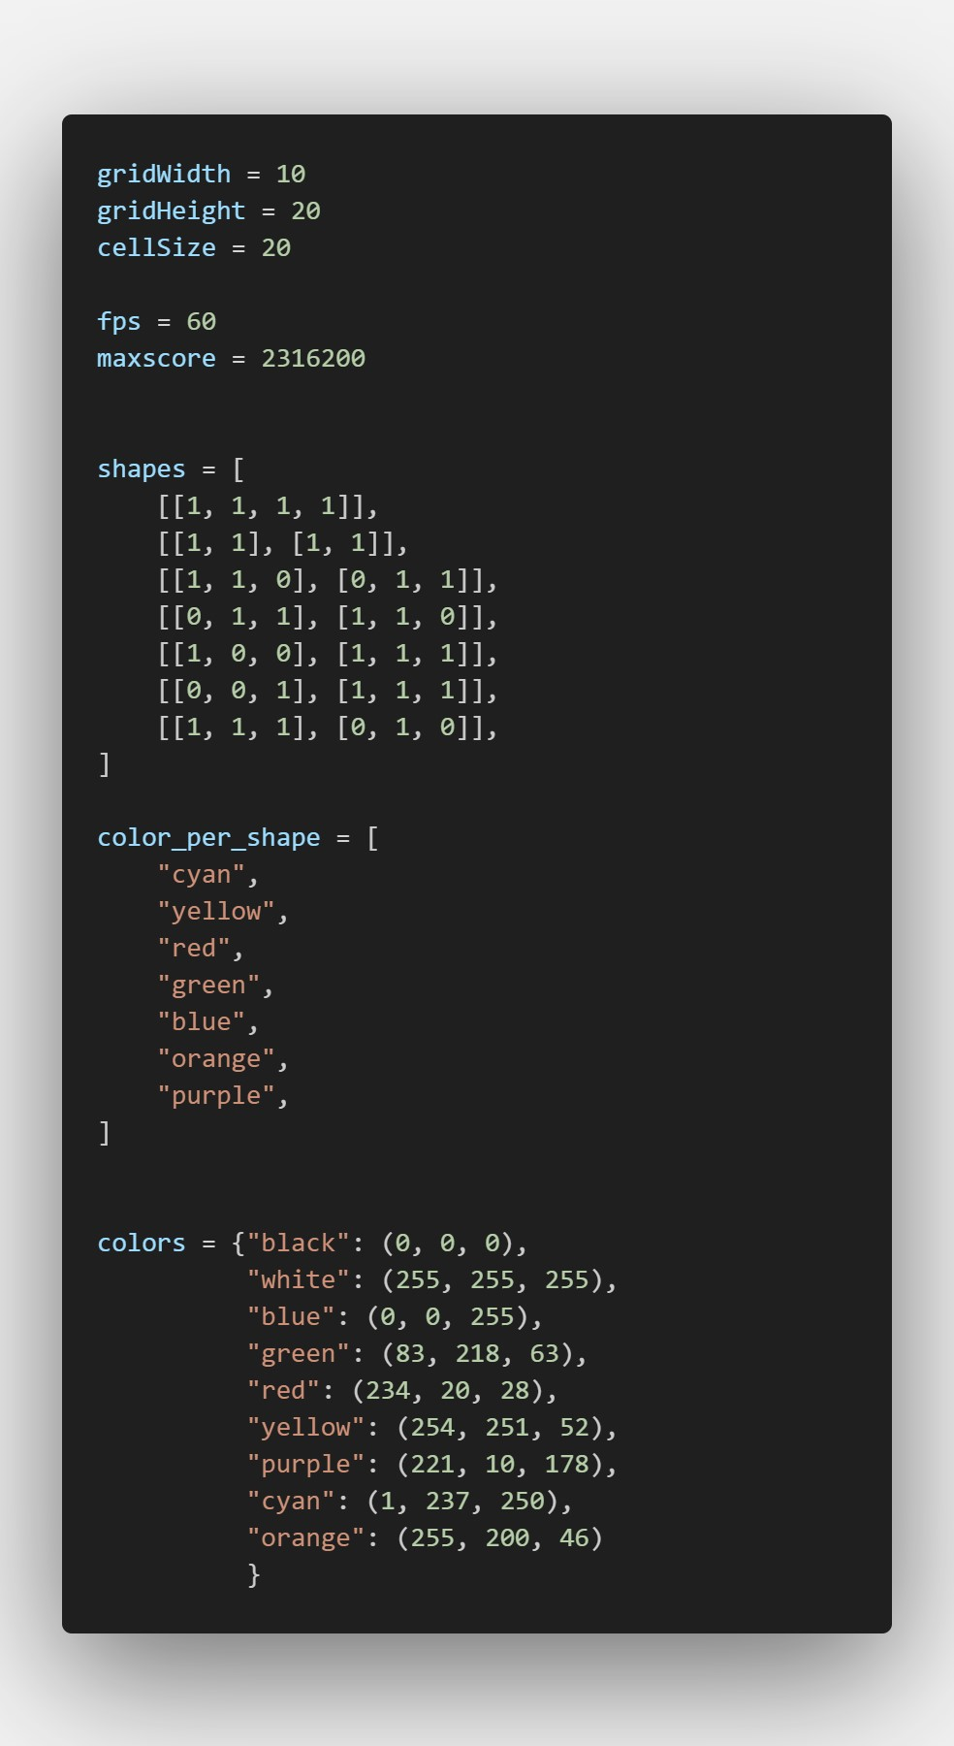
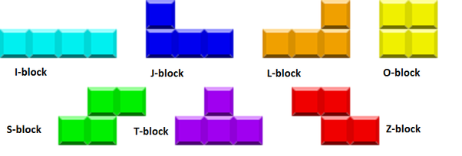
The constants

Slide 4
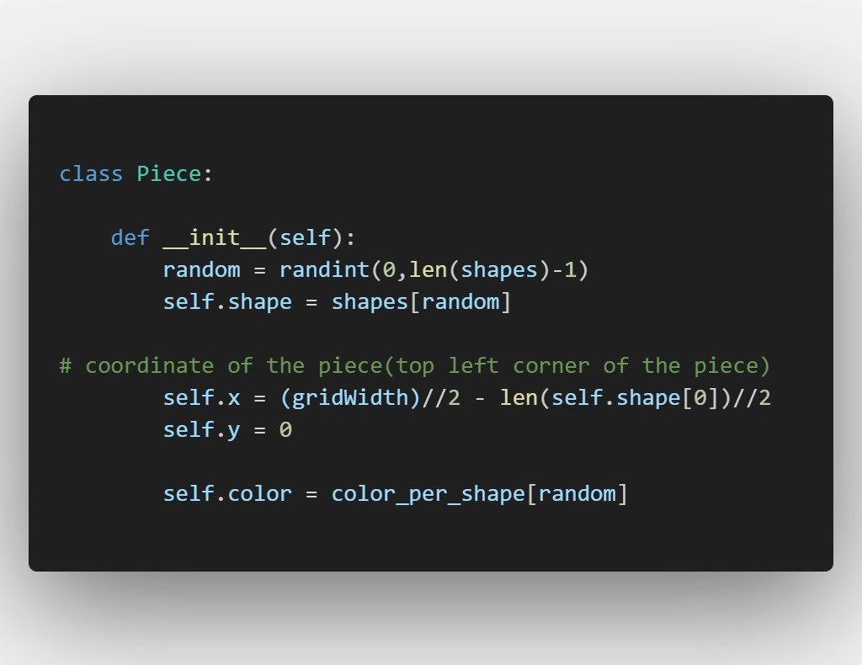
Creation of the Piece

Slide 5
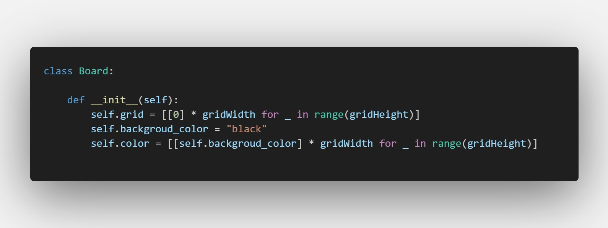
Creation of the board

Slide 6
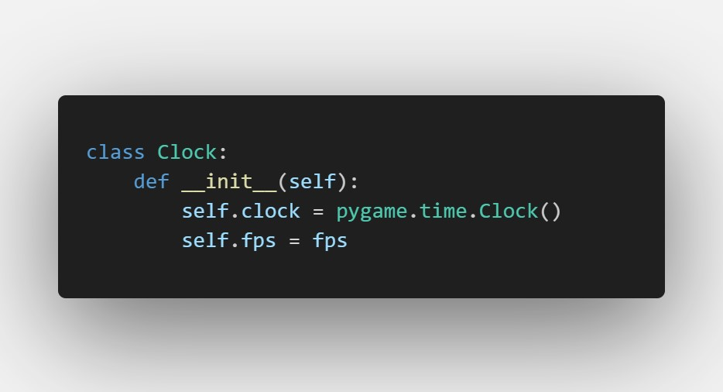
Creation of the clock

Slide 7
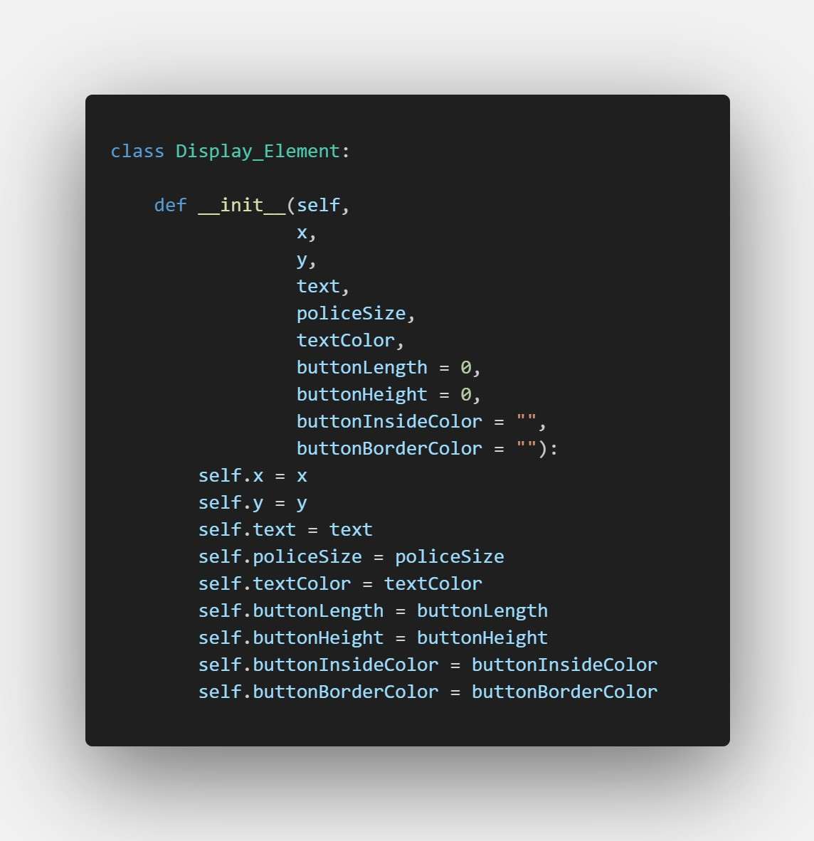
Creation of the display

Slide 8
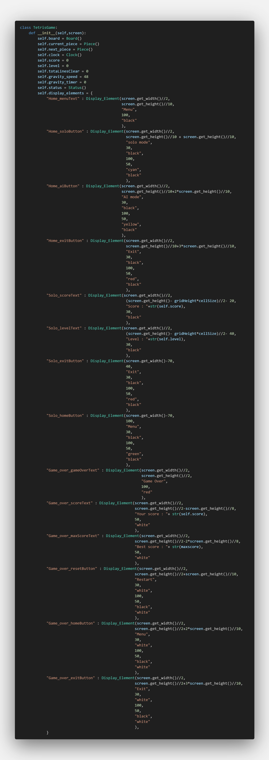

Creation of the game
$$⋮$$

Slide 9
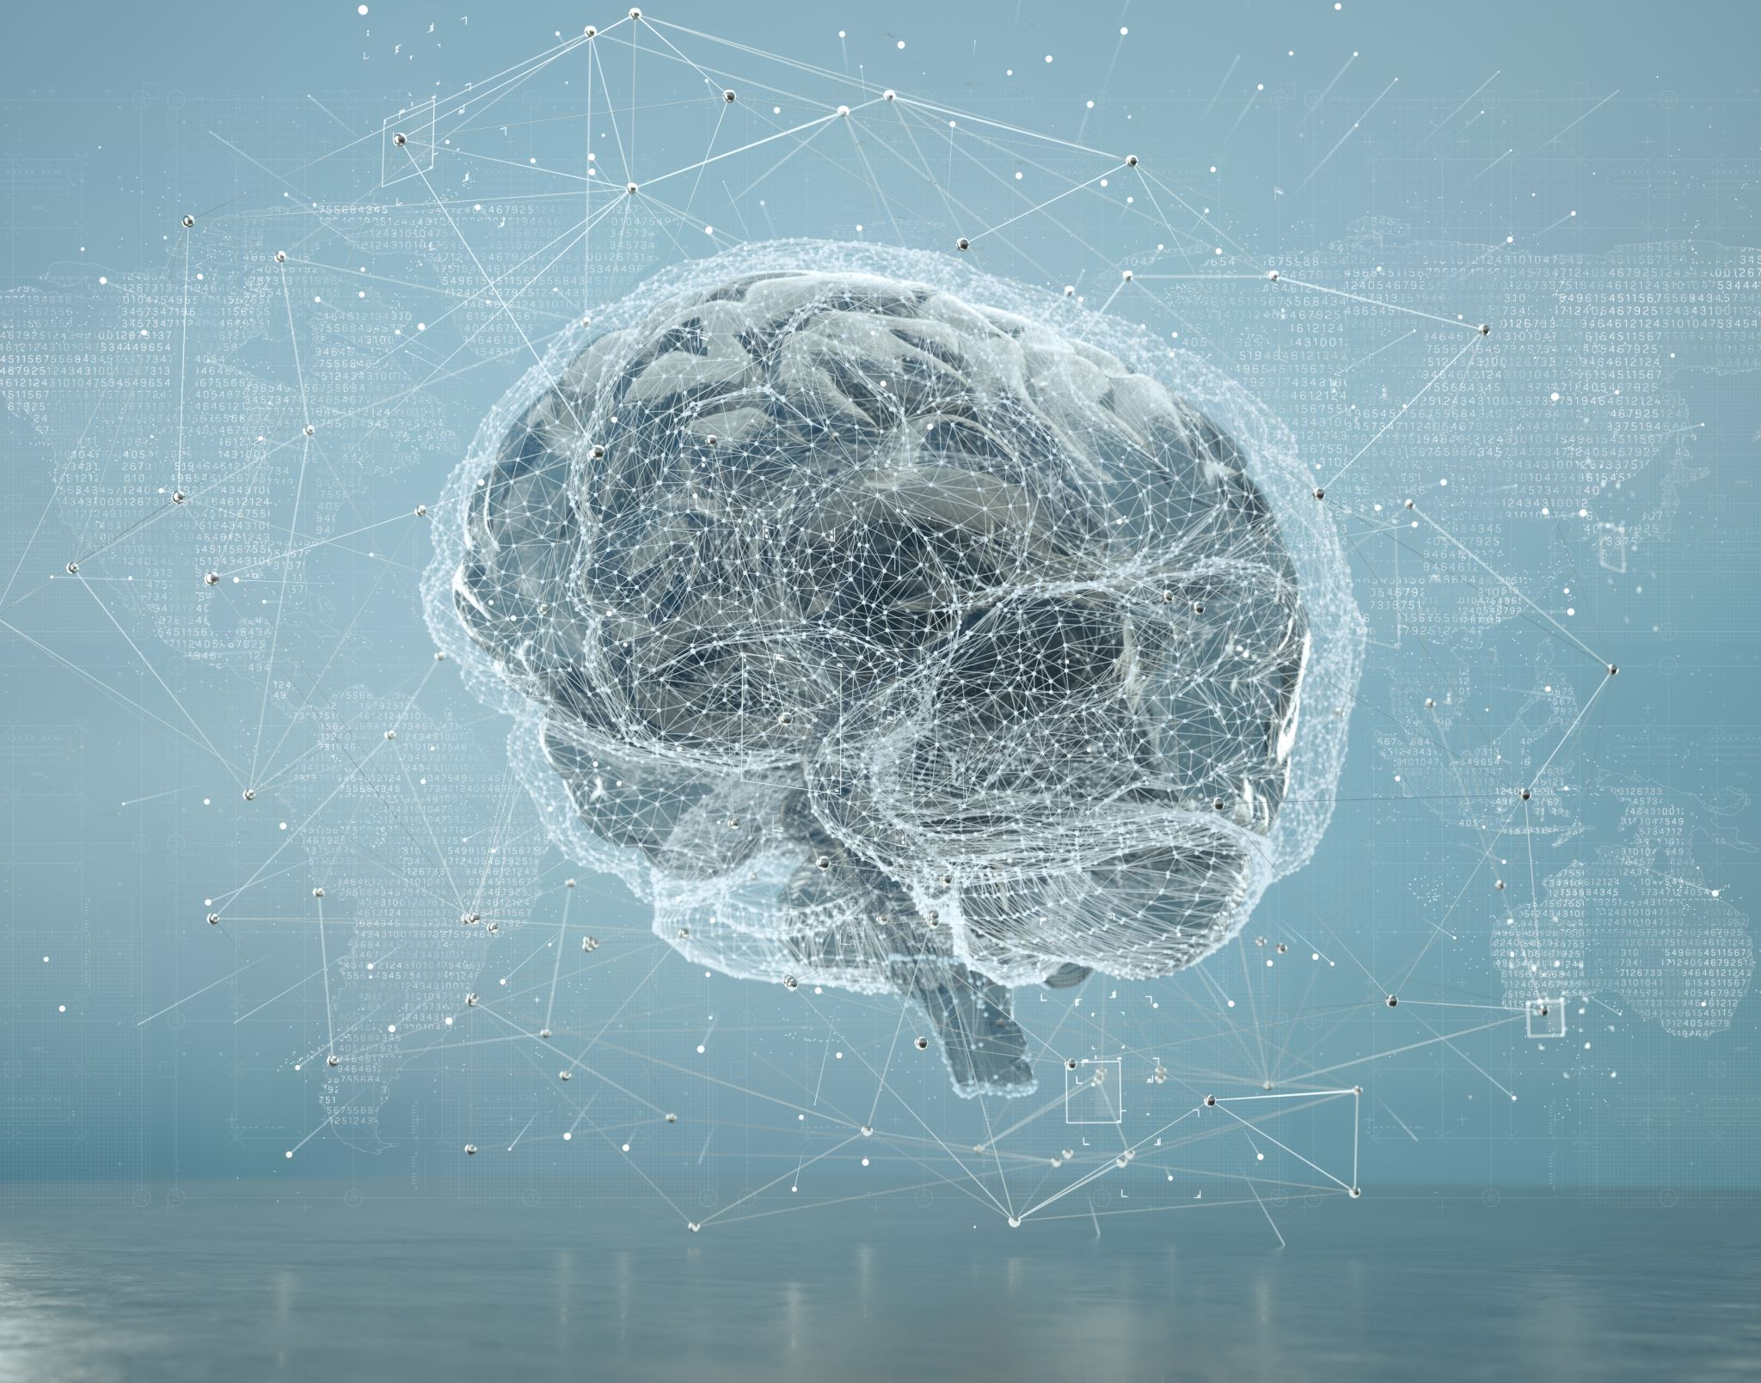
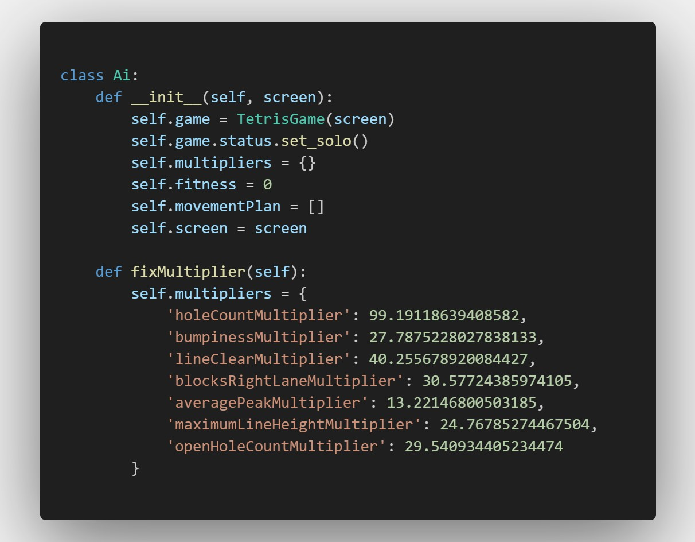
Creation of the AI

Slide 10
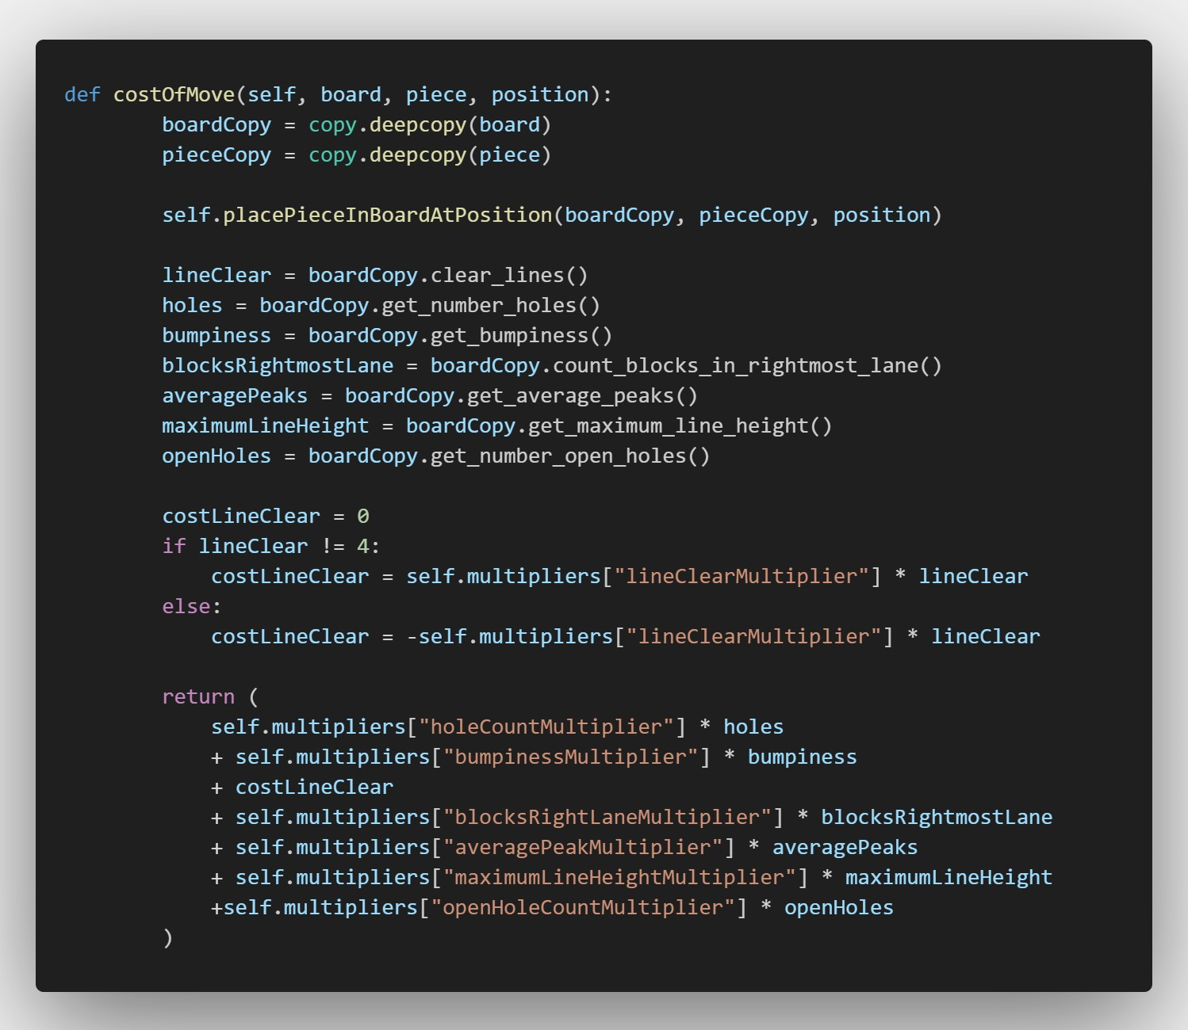
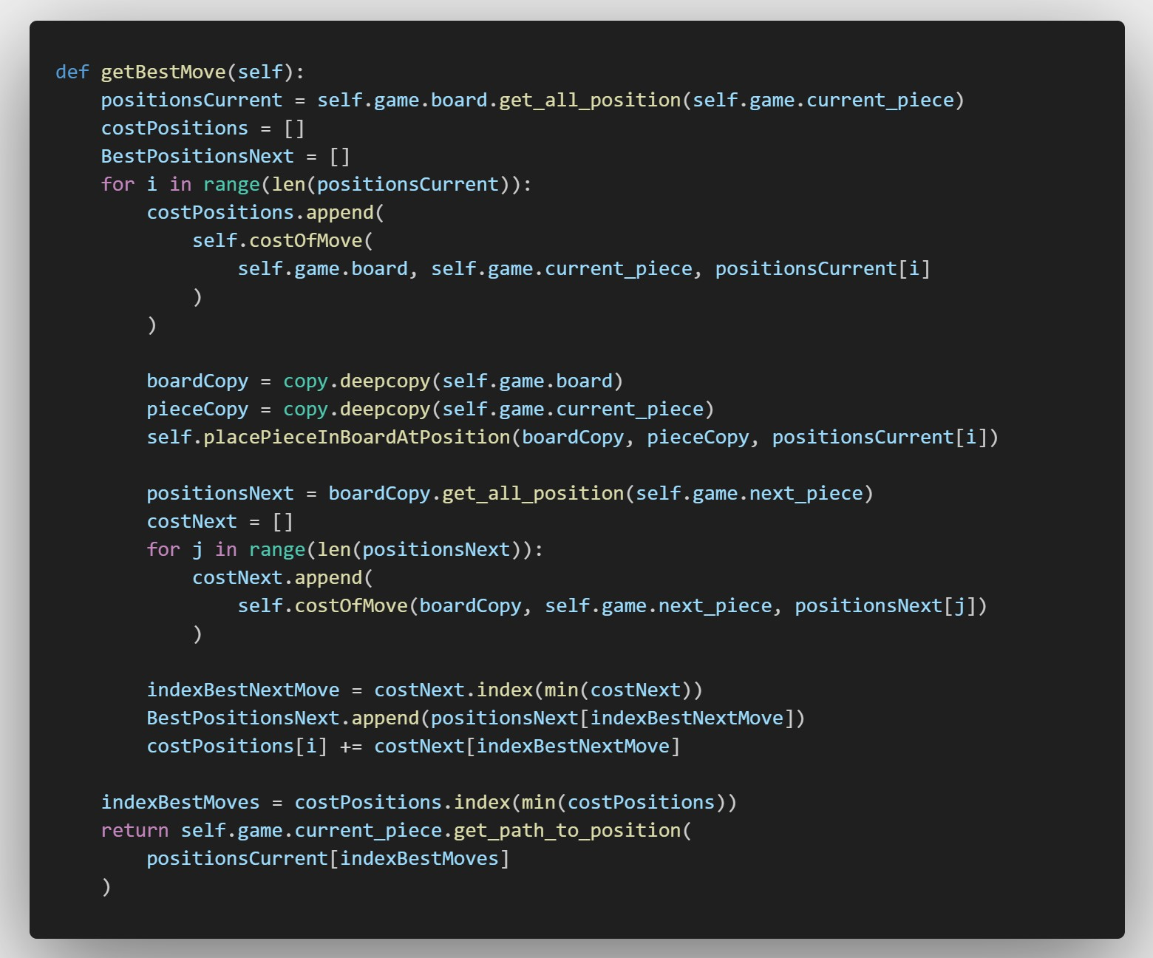
How the AI work

Slide 11
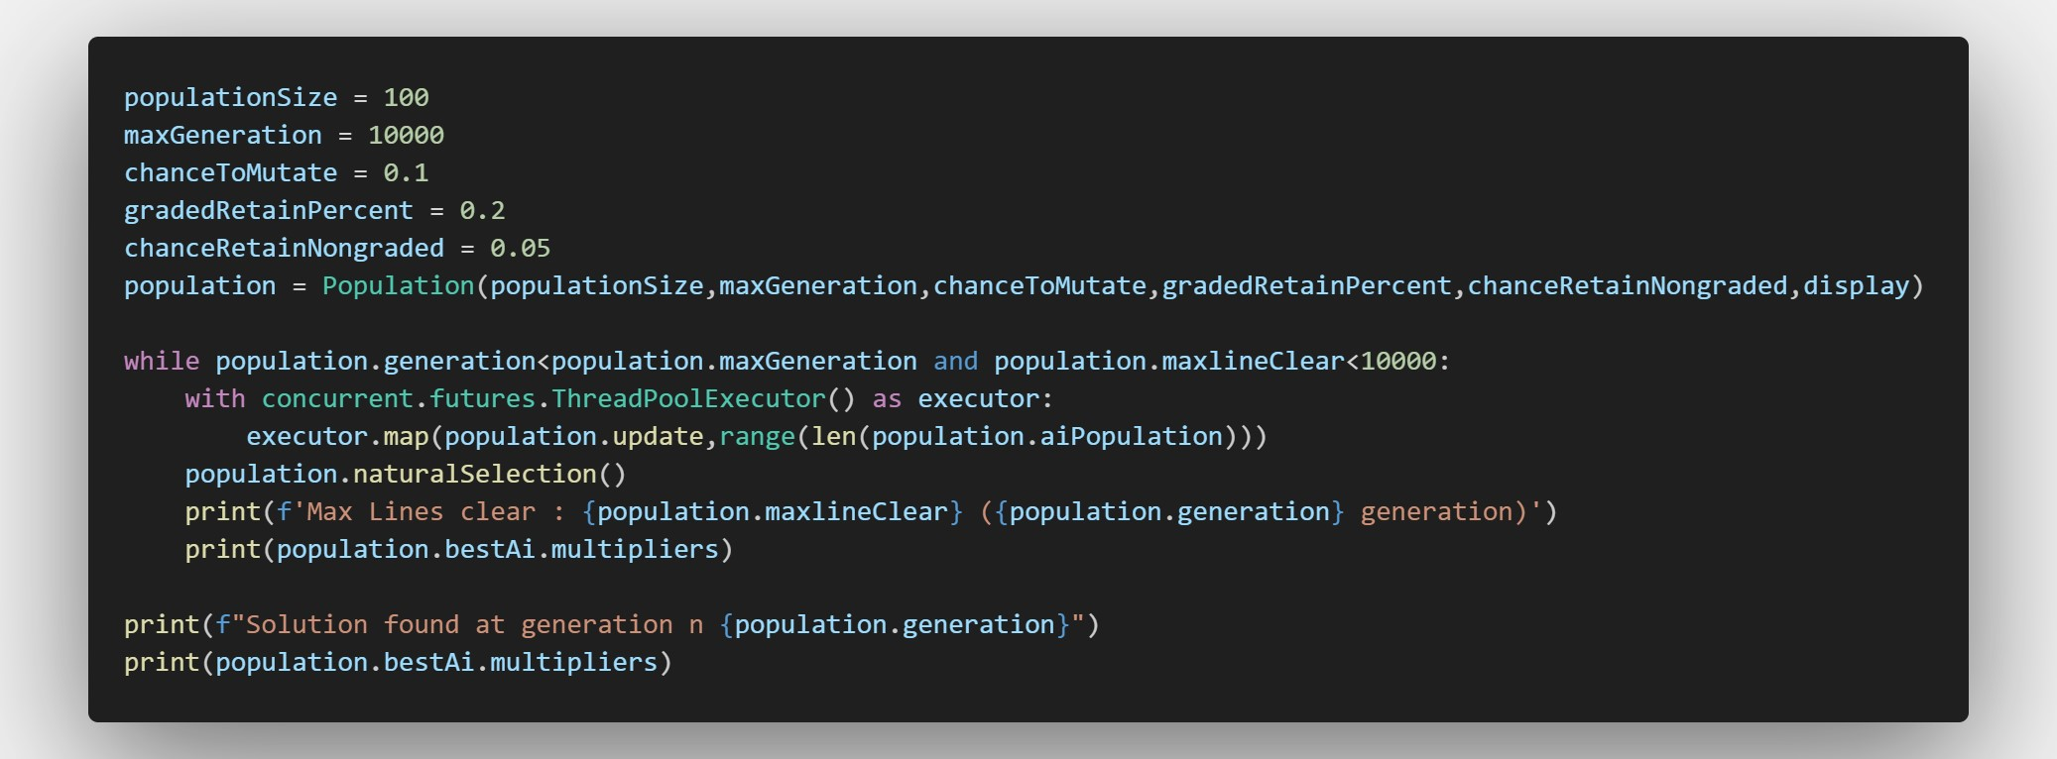
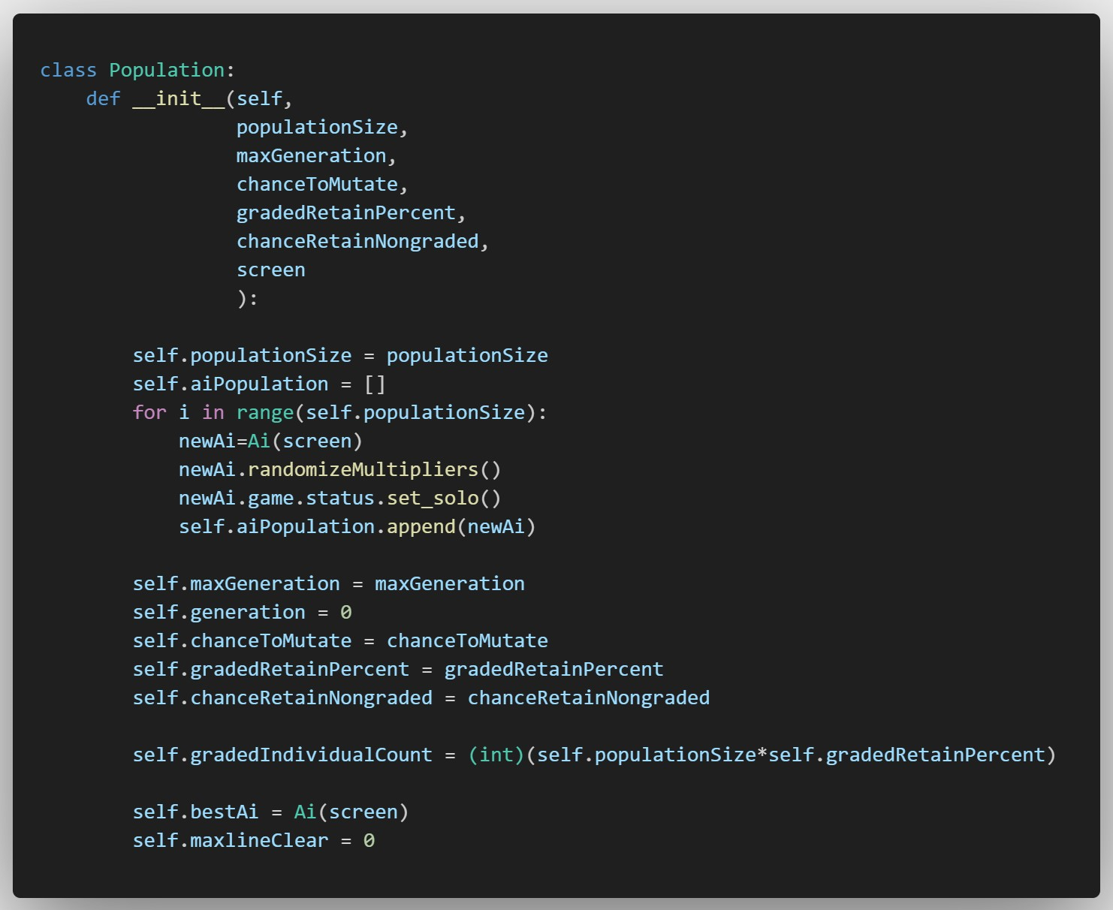
The Genetic algorithm

Slide 12
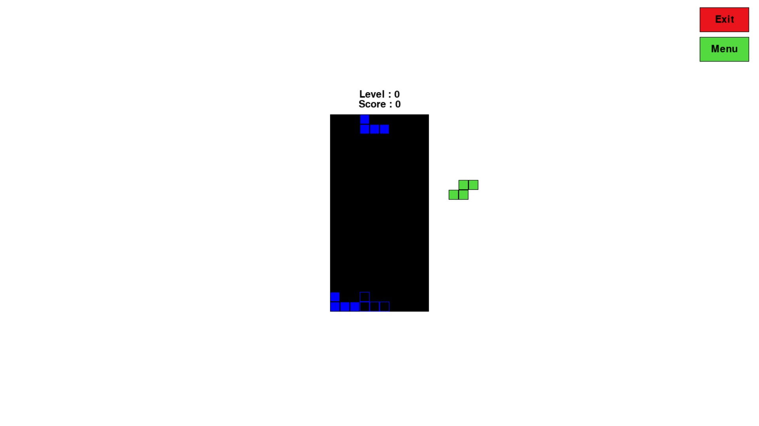
Demo
https://youtu.be/8CYik-HB55k

Slide 13

Thanks for your attention !

